Slide 1

Managing Real-Time Media Flows through a Flow State Exchange
Safiqul Islam, Michael Welzl, David Hayes, Stein Gjessing
Networks and Distributed Systems Group
Department of Informatics
University of Oslo

Slide 2
Outline
Context
Problem Statement
Example Architecture
Flow State Exchange (FSE)
Results
Summary

Slide 3
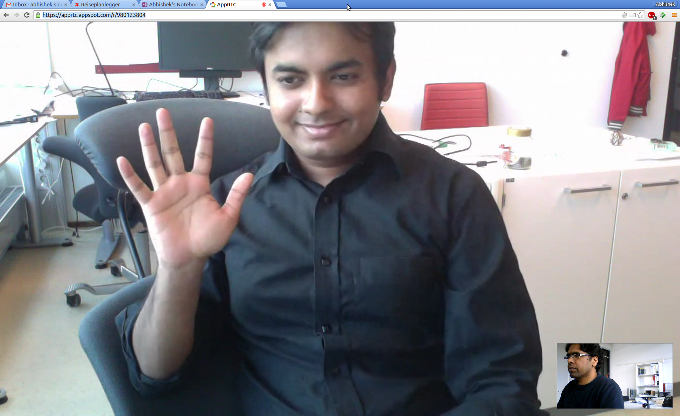
Context/Background
WebRTC/RTCWeb enables real-time communication between web-browsers.

Slide 4
Context/Background
Congestion control for real-time media is delay sensitive
However, Except TFRC, there are no standardized protocols until now
IETF RMCAT WG is formed to develop standards for RTP based Media
Three mechanisms are WG items
Cisco’s Network Assisted (NADA)
Google’s Google Congestion Control
Ericsson’s ScreAm

Slide 5

Problem Statement
Each Flow has its own Congestion Control module
Flow 1
CC
Flow 2
CC
Competition leads to:
CC
Flow 3
More queue growth
More packet drops
More delay
Fairness problems in case of heterogeneous RTTs
CC
Flow n

Slide 6
Problem Statement
This can be solved with a single congestion controller, but it’s too complicated
Congestion Manager
Ensemble-TCP, EFCM
Only for TCP, and requires Extensive changes

Slide 7
Example Architecture
S1
D1
Internet
FSE
S2
D2

Slide 8
Example Architecture
S1
D1
Internet
FSE
S2
D2
Sender host
Destination host

Slide 9
Versions?

Slide 10
Why Passive version doesn’t always work?
…

Slide 11
Adaptation of the algorithm
…

Slide 12
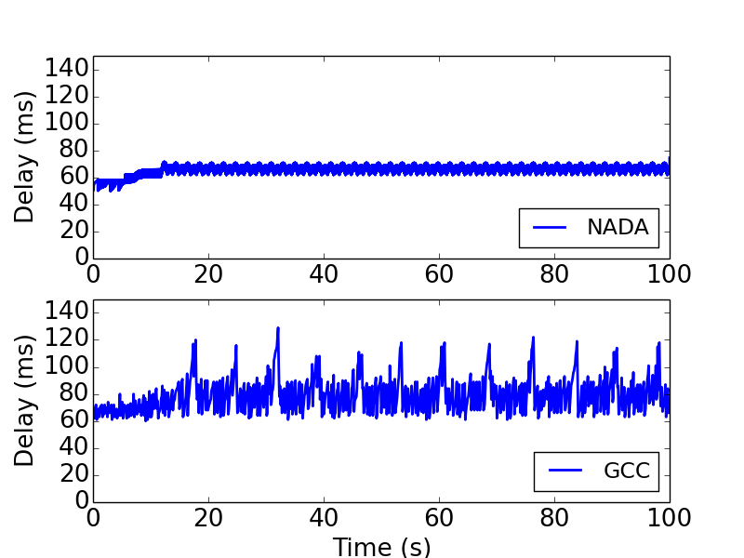
Adaptation of the algorithm

Slide 13
Simulation Testbed
Implemented the mechanism in both Chromium Browser and ns-2
Actual tests and media characteristics are hard to predict
IETF RMCAT group prepared a number of test-cases
Dumbbell topology
With a bottleneck queue of 300ms
We show two pertinent test cases: Round-trip time fairness and media pause and resume
Prioritization test
Delayed feedback test
S1
D1
S2
D2
R1
R2
Sn
Dn

Slide 14
Prioritization Test
Controllable fairness with prioritization is one of the key requirements of WebRTC

Slide 15
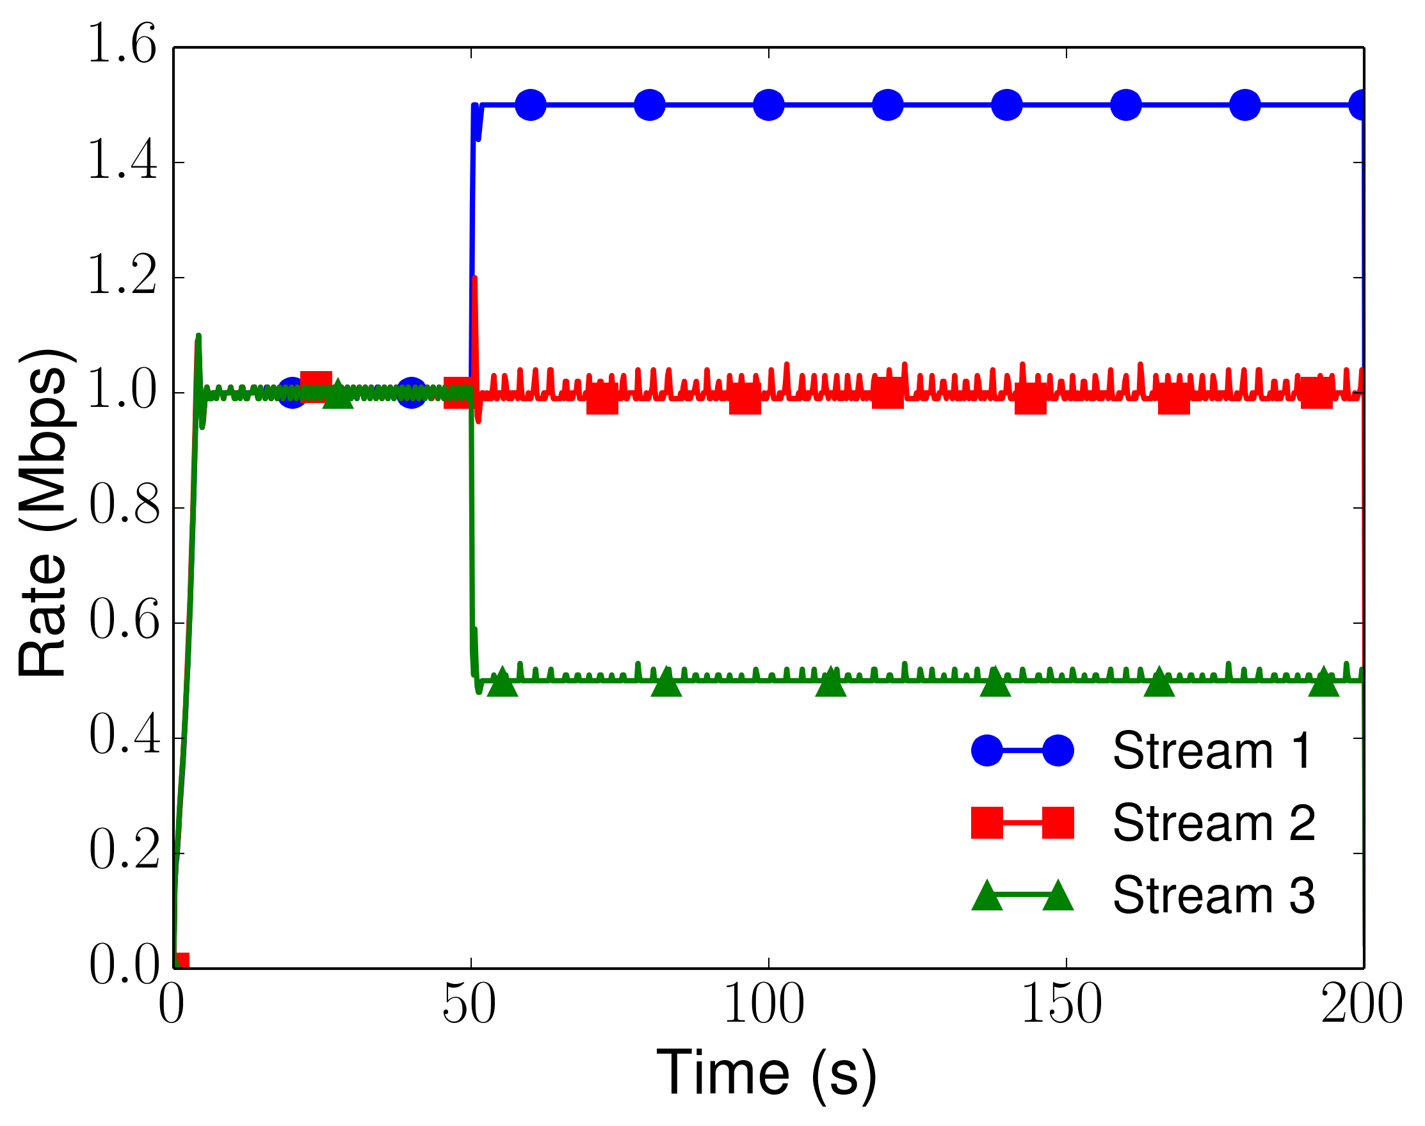
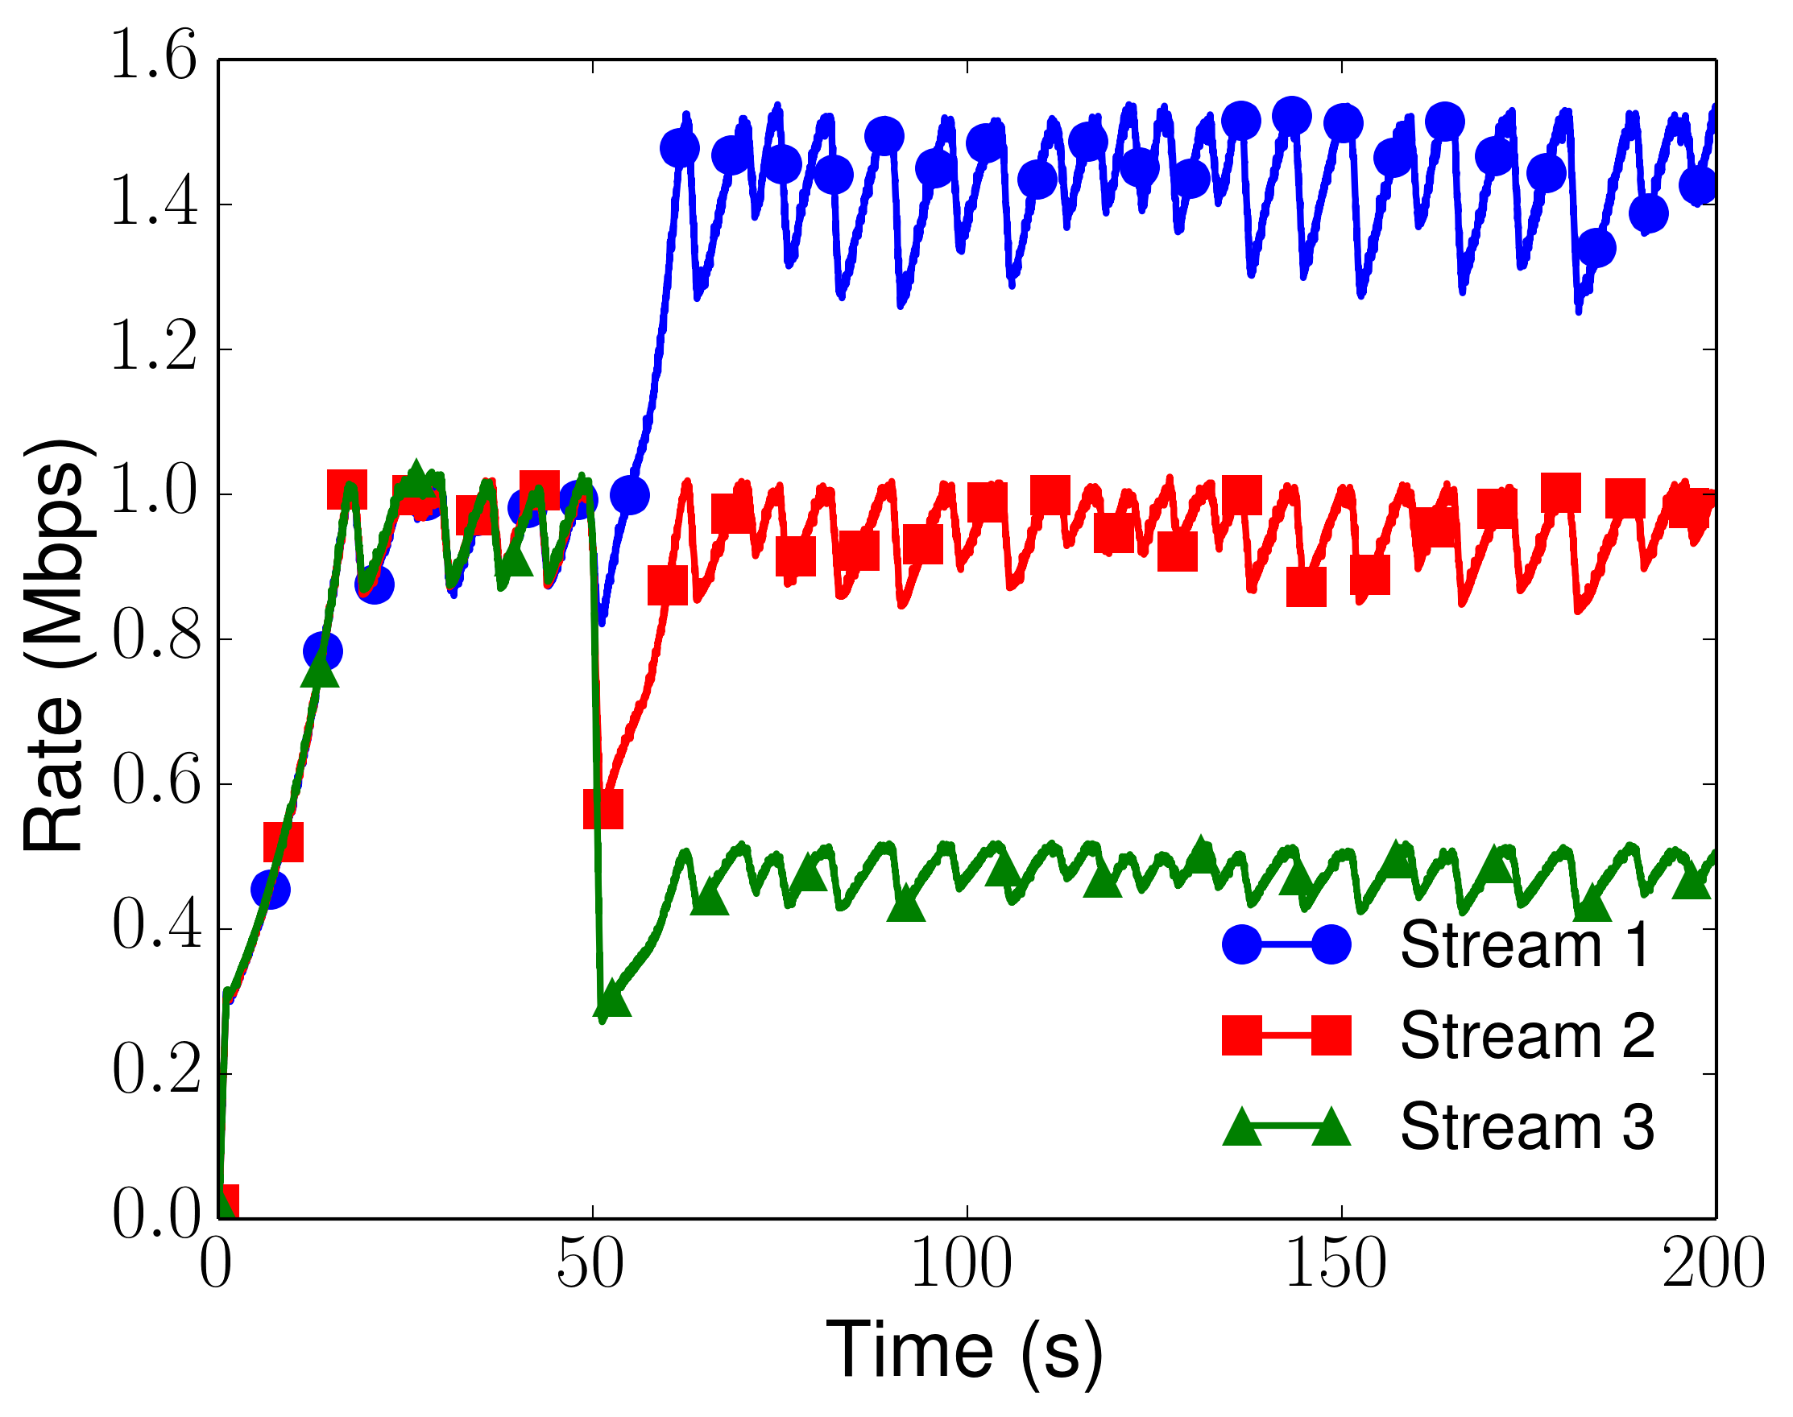
Prioritization Test
The FSE can assign rates based on the priorities assigned from the uses
One way base delay, 50ms

Slide 16
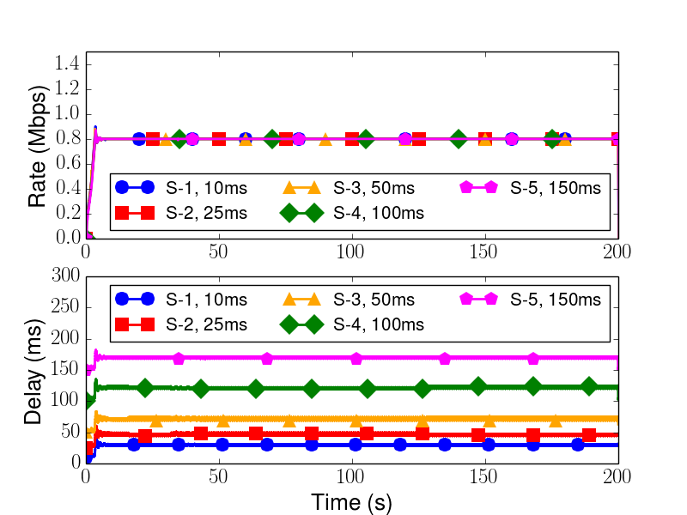
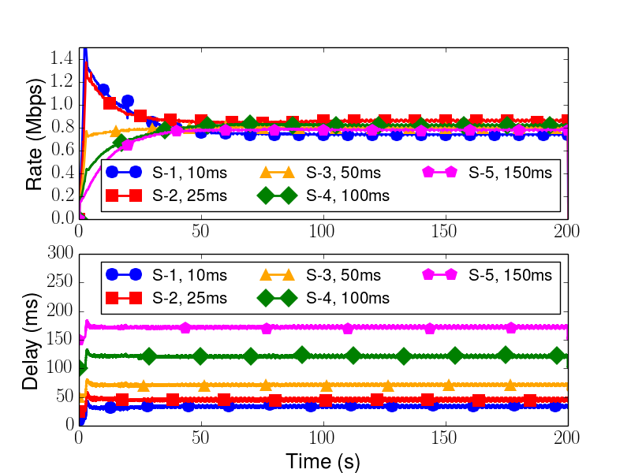
Round-trip time fairness, NADA flows
One-way delays of s1, s2, s3, s4 and s5 are 10ms, 25ms, 50ms, 100ms, and 150ms respectively, and bottleneck capacity, 4Mbps

Slide 17
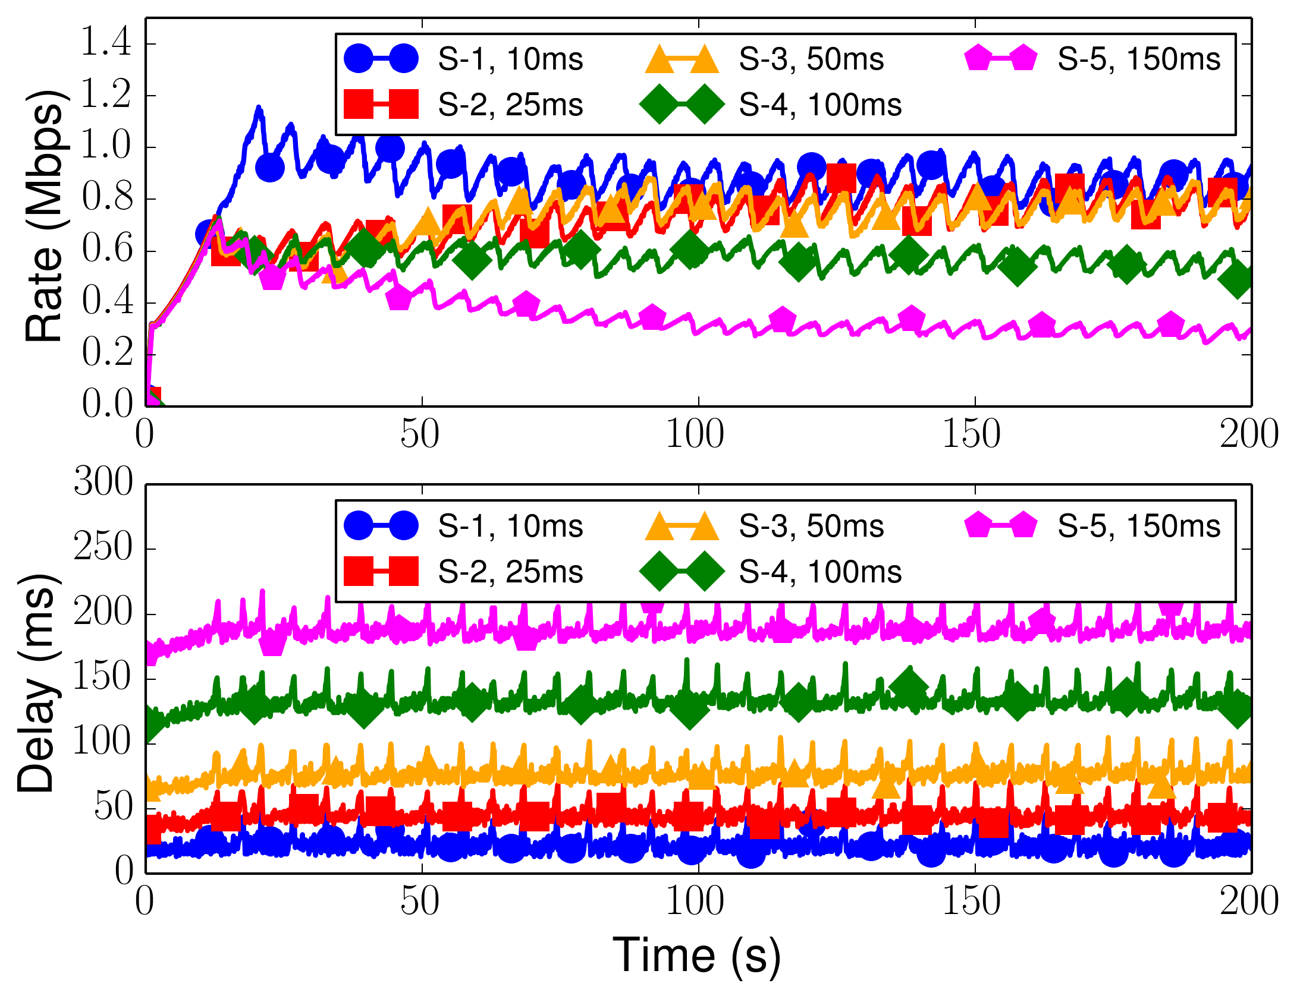
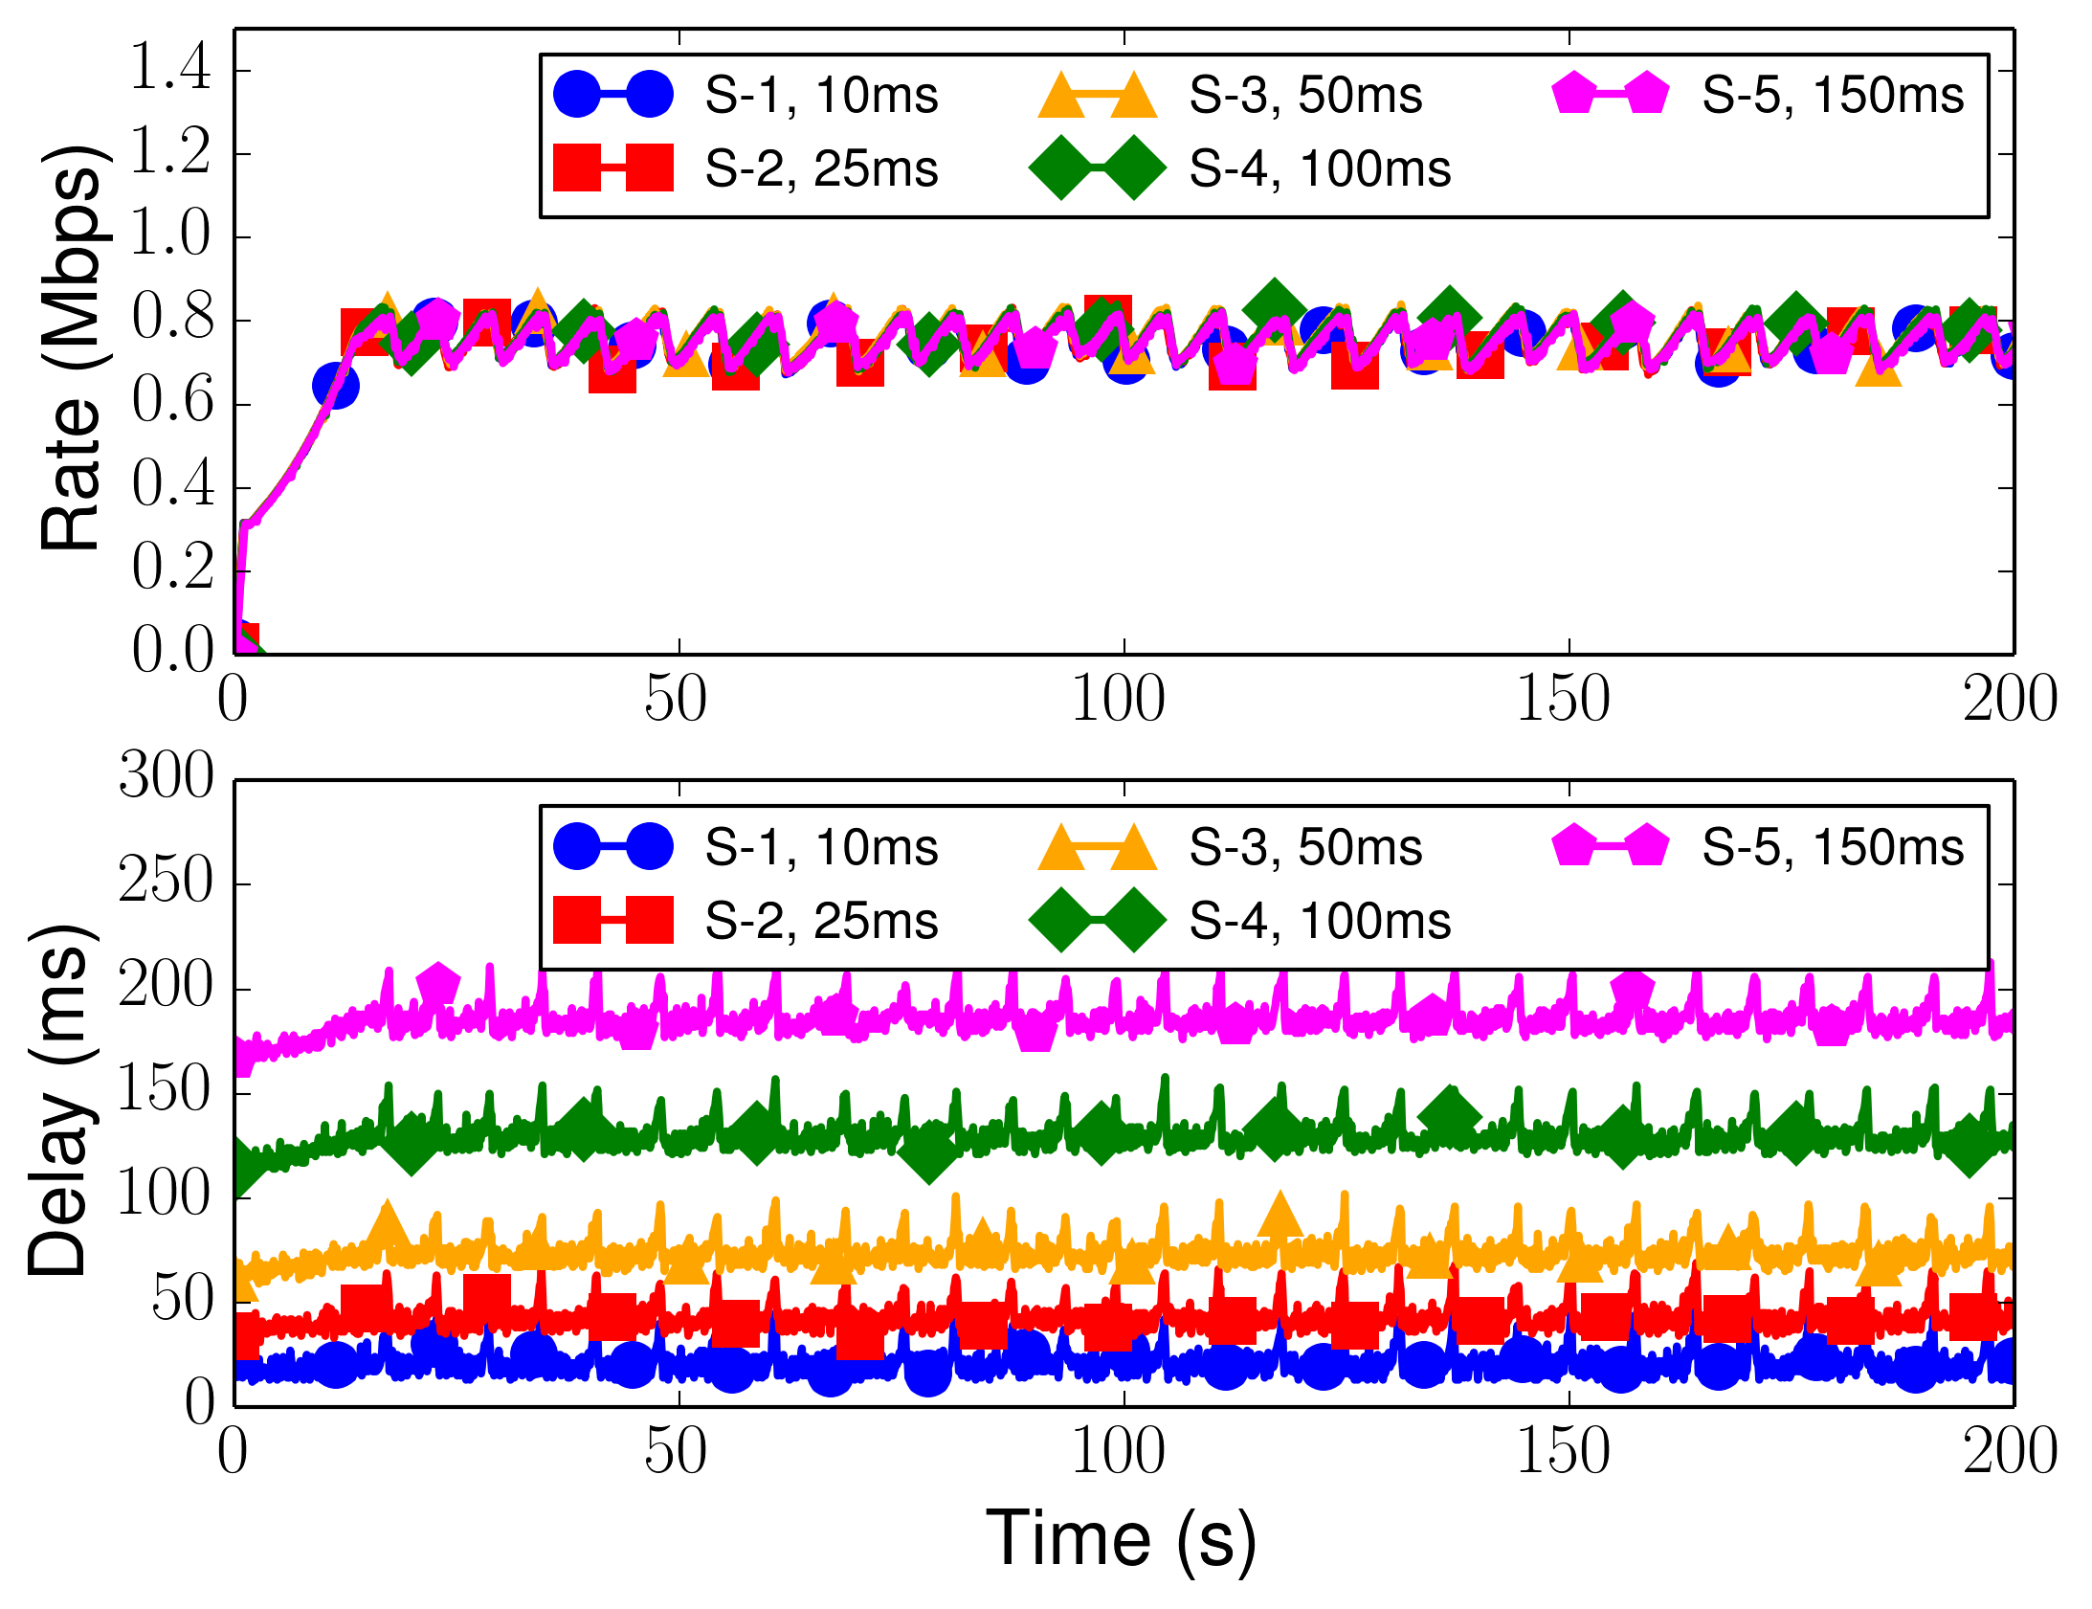
Round-trip time fairness – GCC flows
One-way delays of s1, s2, s3, s4 and s5 are 10ms, 25ms, 50ms, 100ms, and 150ms respectively, and bottleneck capacity, 4Mbps

Slide 18
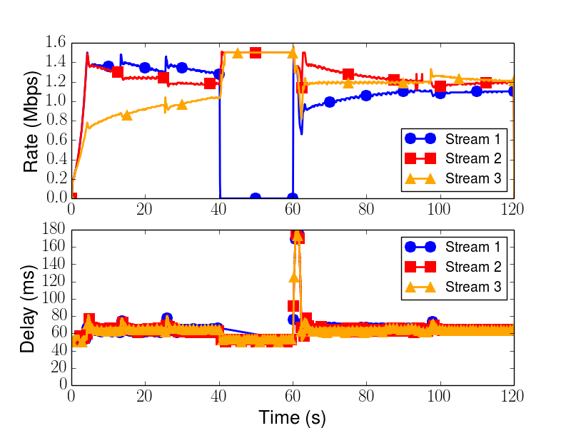
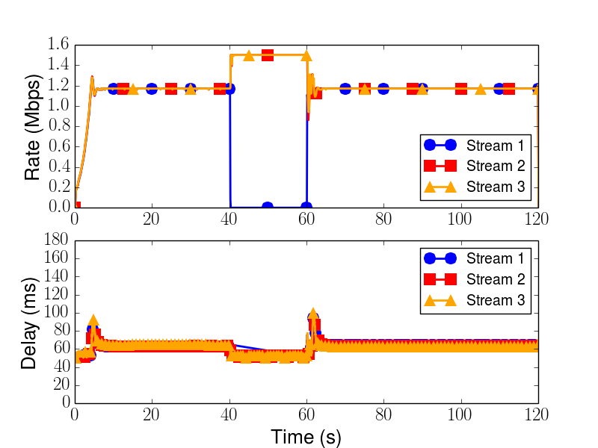
Media Pause and Resume (NADA)
One way delay 50ms and Path capacity 3.5 Mbps

Slide 19
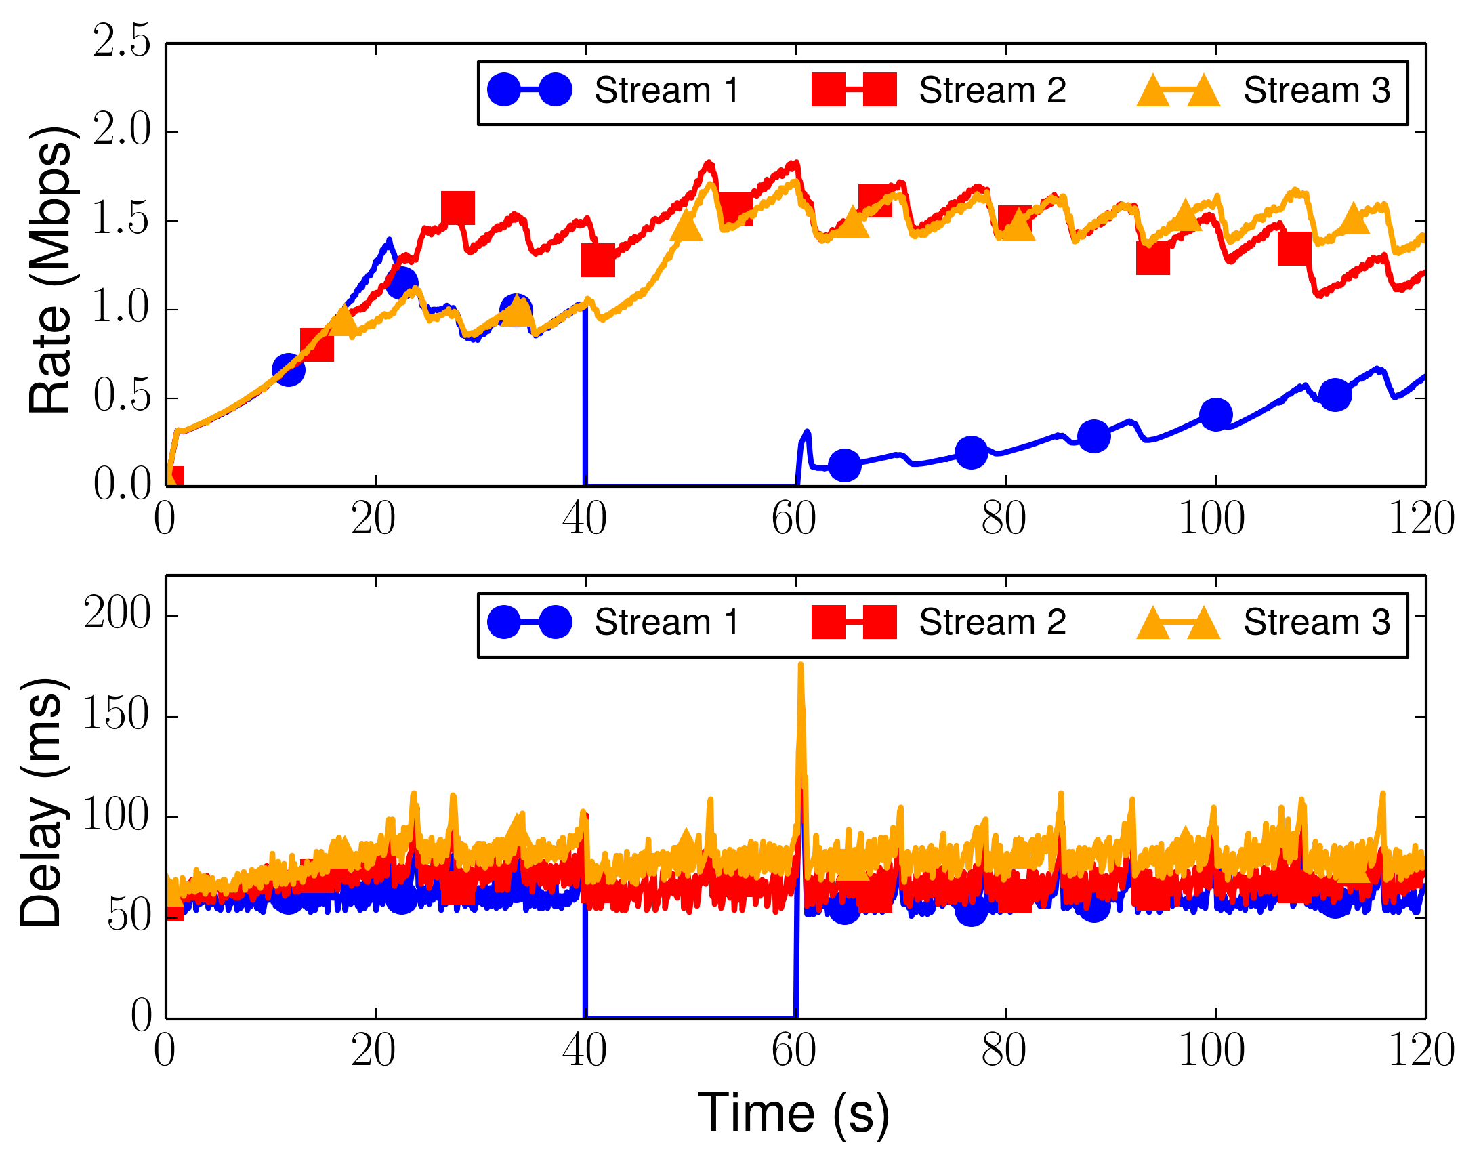
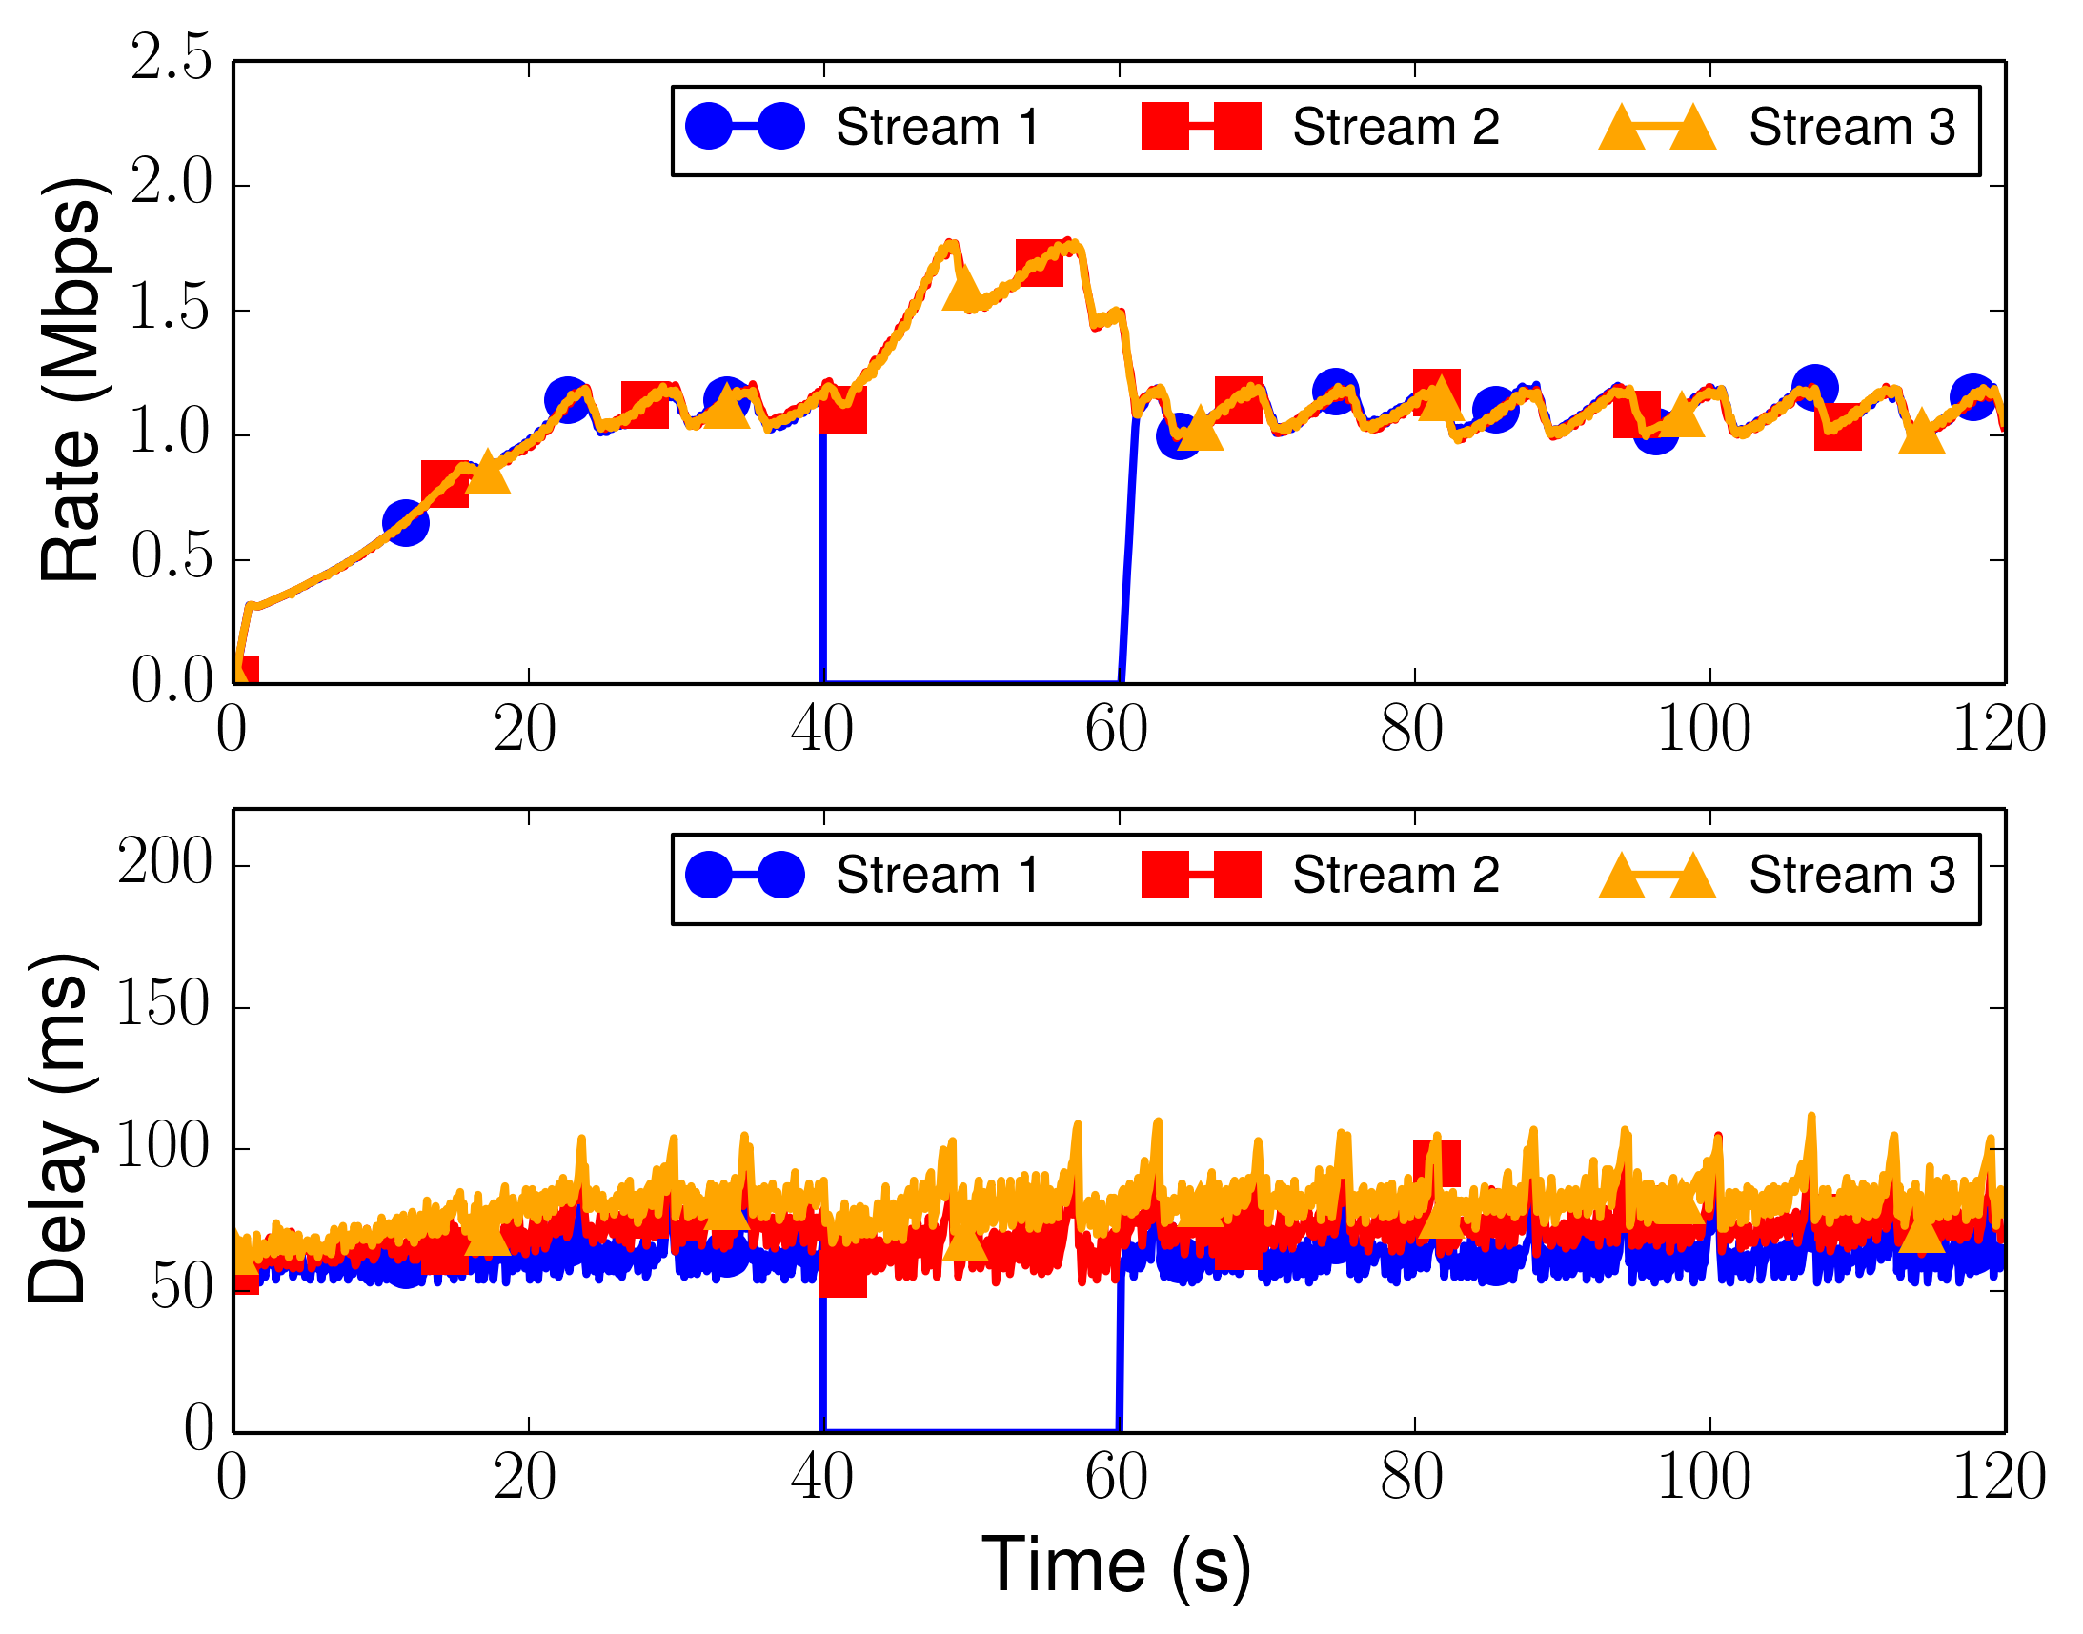
Media Pause and Resume (GCC)
One way delay 50ms and Path capacity 3.5 Mbps
Faster Convergence, Fairness
Slow Convergence
Delay Spike improved
Without FSE
With FSE

Slide 20
Delayed feedback test
Delay between stream 1 and the FSE is delayed
Fixed delay, 50ms
Uniformly distributed
random delay, between
1 and 100
Fixed delay, 100ms

Slide 21
Q&A

